Slide 1
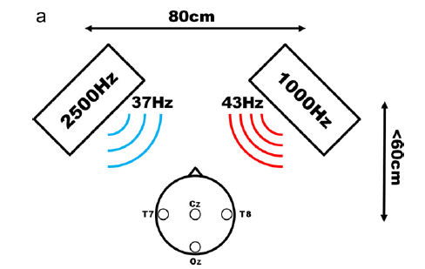
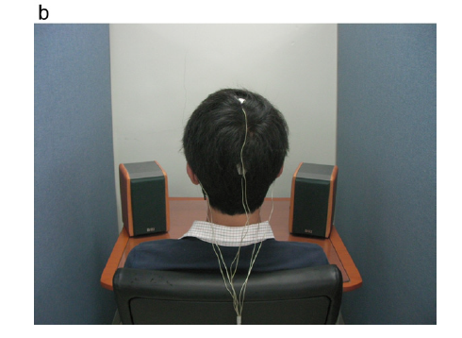

Slide 2
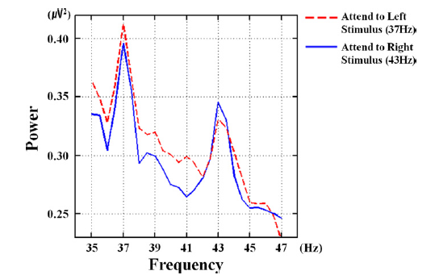

Slide 3
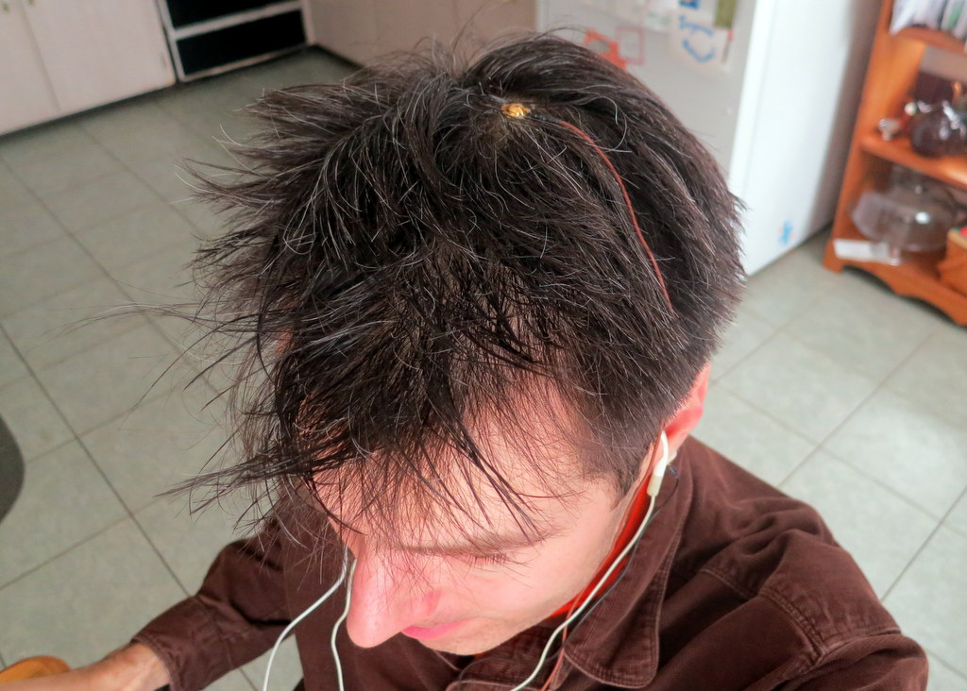
EEG Chan 1 (Cz)
EEG Bias (Ear Lobe)
Ear Bud
(AM Tones)
EEG Ref (Ear Lobe)
Ear Bud
(AM Tones)

Slide 4
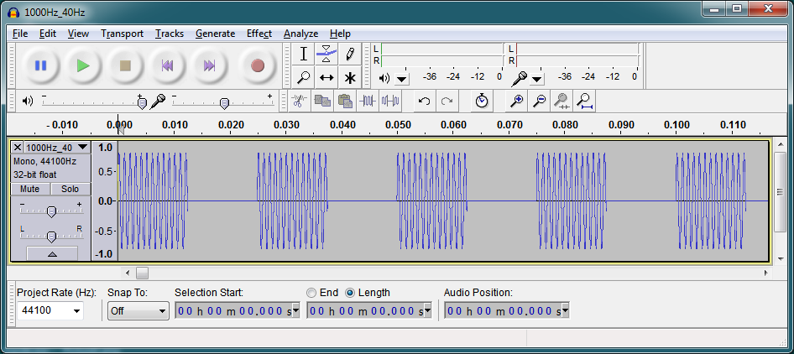

Slide 5
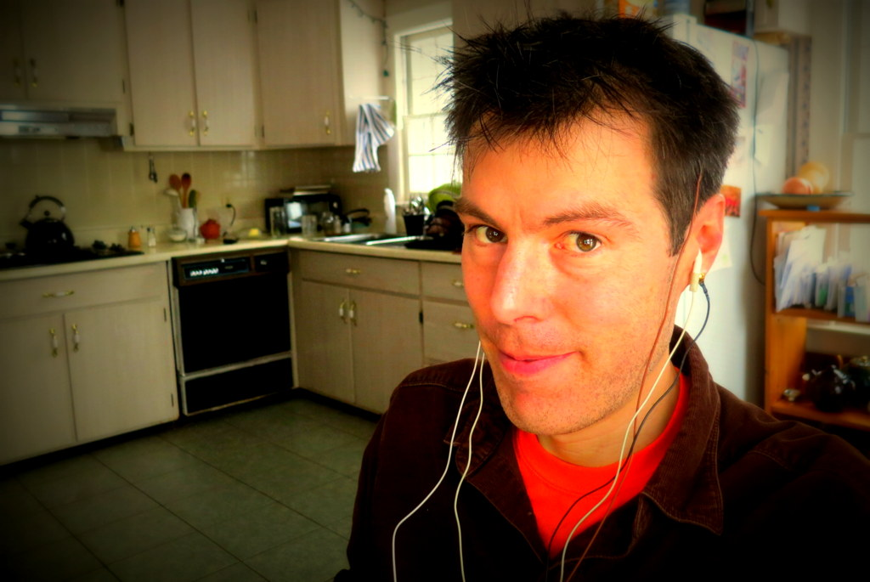
Brain got
Beats?

Slide 6
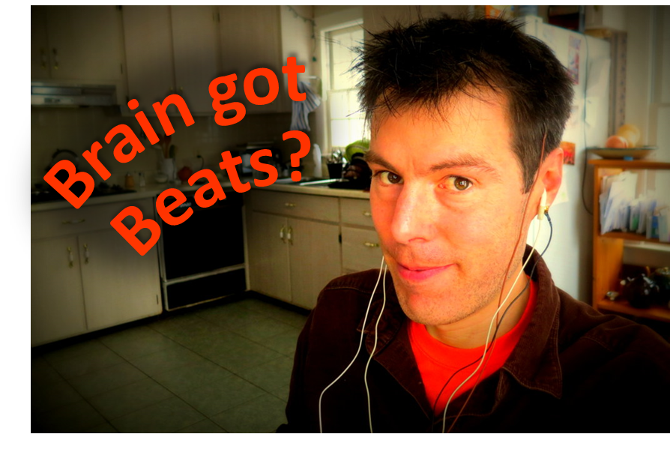

Slide 7
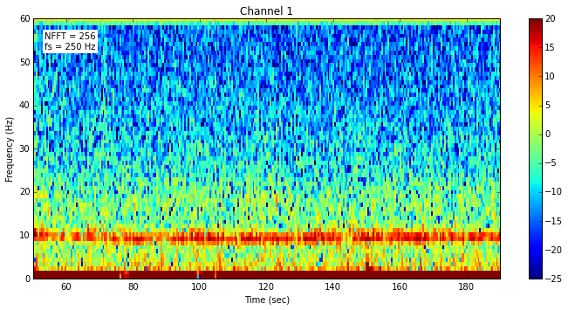
No Response
38-42 Hz
Eyes-Closed
Alpha

Slide 8
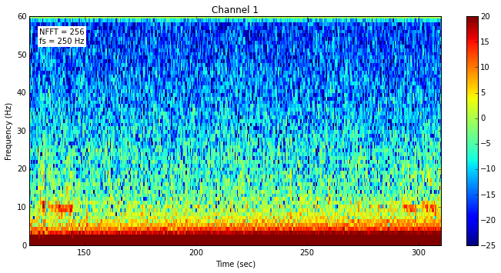
No Response
38-42 Hz

Slide 9
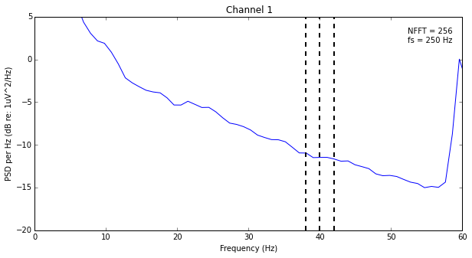
No Peaks
38-42 Hz

